Slide 1
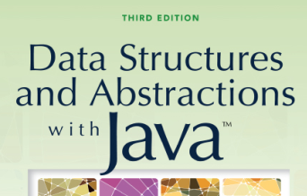

Bags
Copyright ©2012 by Pearson Education, Inc. All rights reserved

Slide 2
Contents
The Bag
  A Bag’s Behaviors
Specifying a Bag
  An Interface
Using the ADT Bag
Using an ADT Is Like Using a Vending Machine
Copyright ©2012 by Pearson Education, Inc. All rights reserved

Slide 3
Objectives
Describe the concept of abstract data type (ADT)
Describe ADT bag
Use ADT bag in Java program
Copyright ©2012 by Pearson Education, Inc. All rights reserved

Slide 4
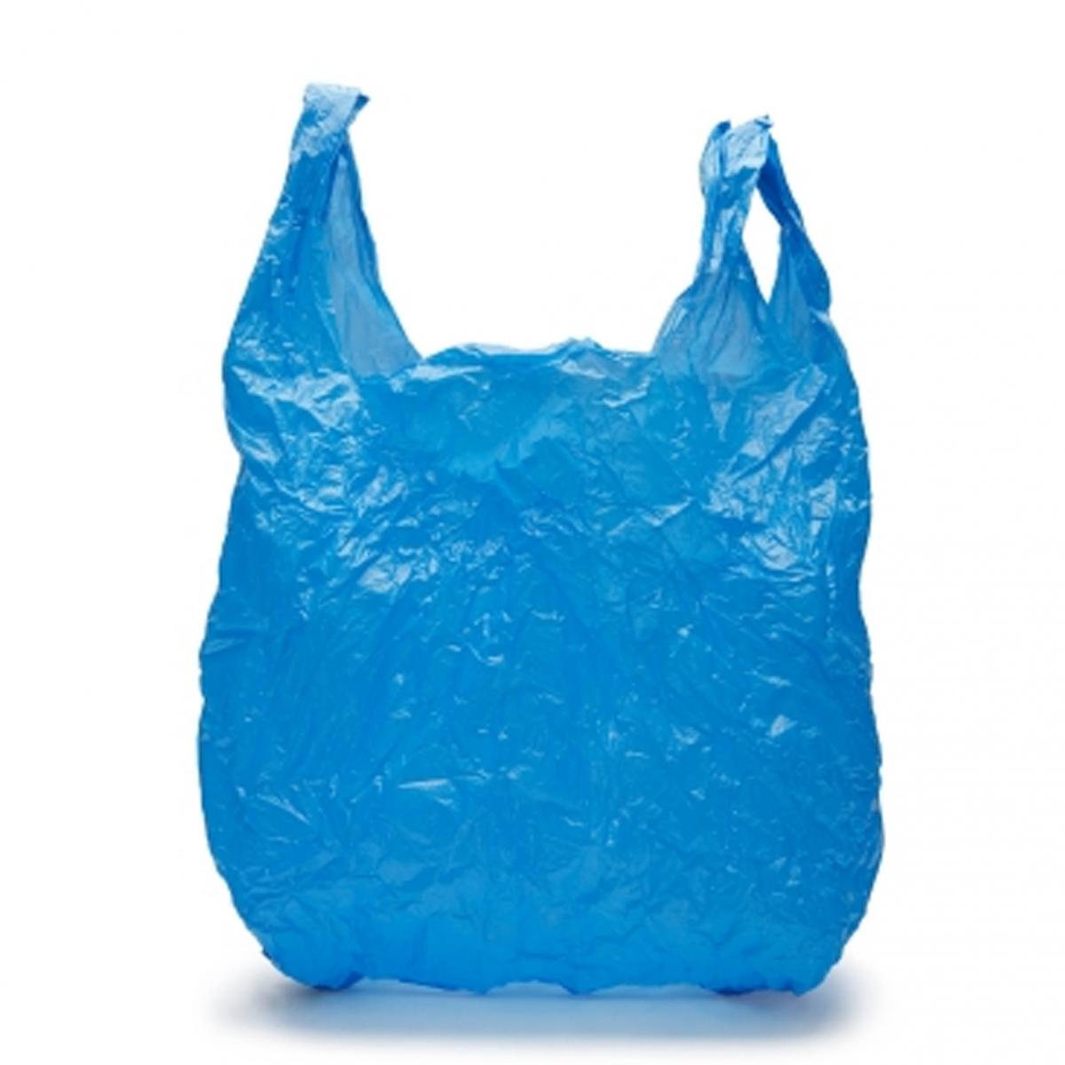

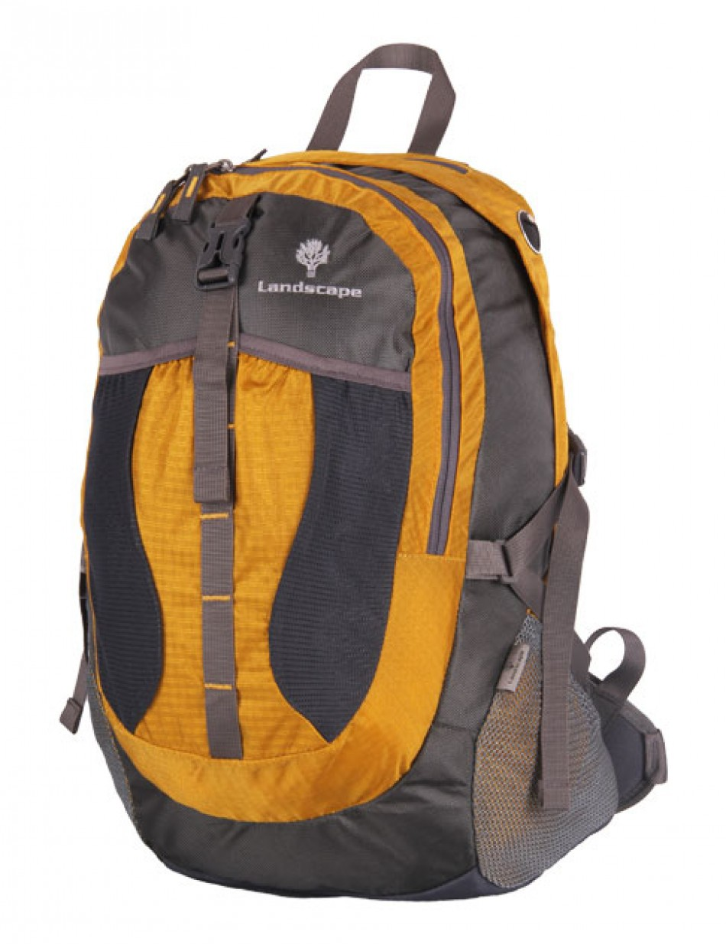
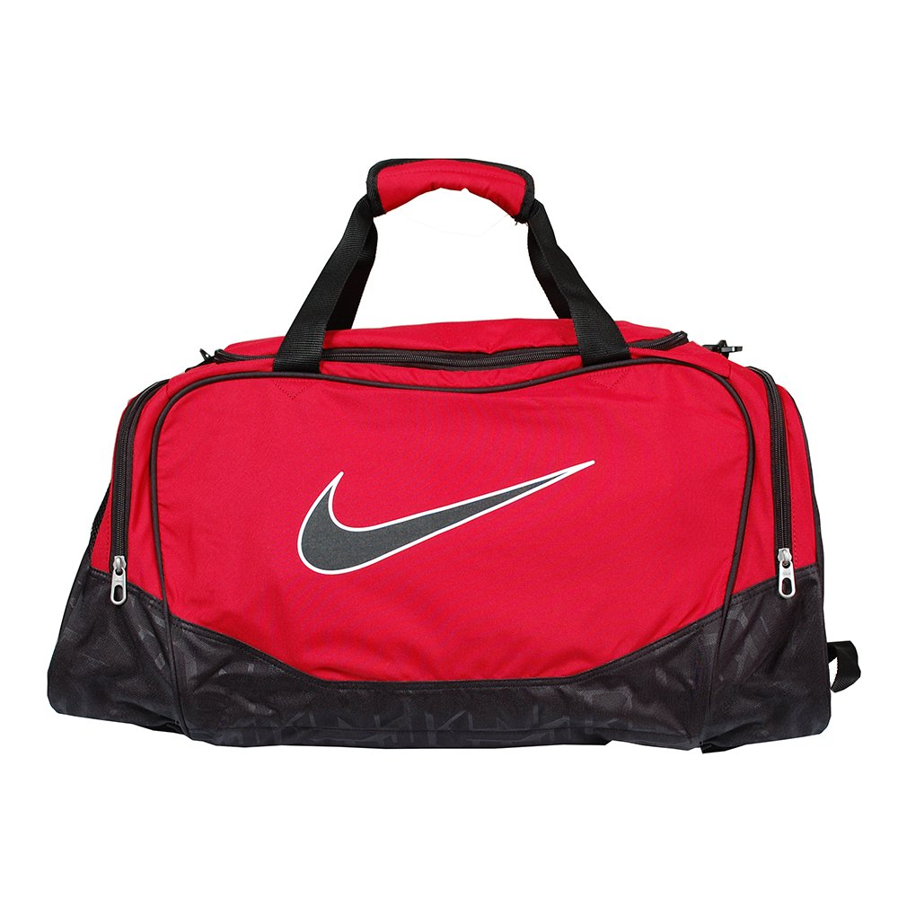
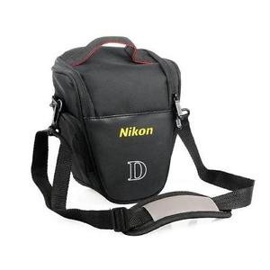
What items?
What operations?
Copyright ©2012 by Pearson Education, Inc. All rights reserved

Slide 5
Yes or No?
Should the items be stored in a specific order?
Can you keep repetitive items in the same bag?
Is there a standard limit/number of items to be stored in the bag?
Copyright ©2012 by Pearson Education, Inc. All rights reserved

Slide 6
Definition: Bag
A finite collection of objects
In no particular order
May contain duplicate items
Copyright ©2012 by Pearson Education, Inc. All rights reserved

Slide 7
A simple ADT : A bag
A bag is just a container for a group of data items.
  analogy: a bag of candy
The positions of the data items don’t matter (unlike a list).
  {3, 2, 10, 6} is equivalent to {2, 3, 6, 10}
The items do not need to be unique (unlike a set).
  {7, 2, 10, 7, 5} isn’t a set, but it is a bag

Slide 8
Behaviors
Determine how many objects in bag
  Full?
  Empty?
Add, remove objects
Count duplicates
Test for specific object
View all objects
Copyright ©2012 by Pearson Education, Inc. All rights reserved

Slide 9
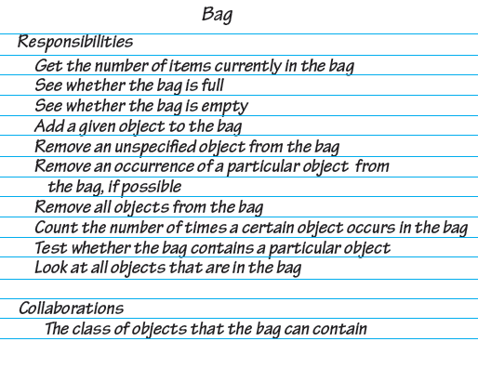
Figure 1-1 A CRC card for a class Bag
Exercise : Convert these requirements into appropriate method signatures as class and as interface

Slide 10
Hints : Specifying a Bag
Describe data
Specify methods for bag’s behaviors
  Name methods
  Choose parameters
  Decide return types
  Write comments
Copyright ©2012 by Pearson Education, Inc. All rights reserved

Slide 11
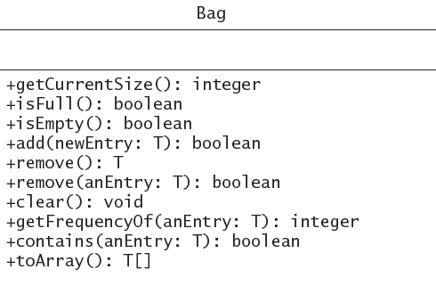
Answer: UML notation for the class Bag

Slide 12
Example: Bag Interface
public interface Bag {
  boolean add(Object item);
  boolean remove(Object item);
  boolean contains(Object item);
  int numItems();
  Object grab();
  Object[] toArray();
}
Note : An interface specifies a set of methods.
• includes only the method headers
• cannot include the actual method definitions
Copyright ©2012 by Pearson Education, Inc. All rights reserved

Slide 13
Implementing ADT using a Class
To implement an ADT, we define a class:
  public class ArrayBag implements Bag {
    private Object[] items;
    private int numItems;
    …
    public boolean add(Object item) {
    …
    }
  }
Note : When a class header includes an implements clause, the class must define all of the methods in the interface.
Copyright ©2012 by Pearson Education, Inc. All rights reserved

Slide 14
Design Decisions
What should the method add do when it cannot add a new entry?
  Nothing?
  Leave bag unchanged, signal client of condition?
Copyright ©2012 by Pearson Education, Inc. All rights reserved

Slide 15
Design Decisions
What should happen when an unusual condition occurs?
  Assume invalid never happens?
  Ignore invalid event?
  Guess at client’s intention?
  Return flag value?
  Return boolean value – success/failure?
  Throw exception?
Copyright ©2012 by Pearson Education, Inc. All rights reserved

Slide 16
Interface
Write Java headers
Organize into interface
Note items in bag are of same type
  Generic type <T>
View Listing 1-1
Note: Code listing files
must be in same folder
as PowerPoint files
for links to work
Copyright ©2012 by Pearson Education, Inc. All rights reserved

Slide 17
Using ADT Bag
Implementation done from specifications
  User needs know what ADT does, not how
Type of object in bag specified by program using the ADT
Example of Bag for online shopping
Listing 1-2
Copyright ©2012 by Pearson Education, Inc. All rights reserved

Slide 18

Using ADT Bag
Example of Bag for class of piggy banks
Listing 1-3
Demonstration of class PiggyBank
Listing 1-4
Copyright ©2012 by Pearson Education, Inc. All rights reserved

Slide 19
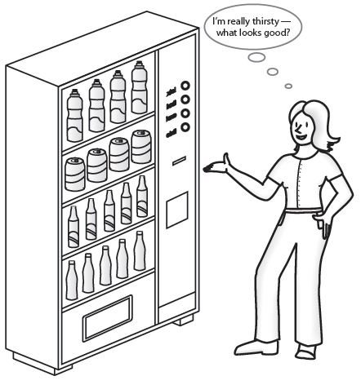
Figure 1-3 A Vending Machine

Slide 20
Vending Machine Like An ADT
Perform only available tasks
User must understand the tasks
Cannot access inside of mechanism
Usable without knowing inside implementation
New inside implementation unknown to users
Copyright ©2012 by Pearson Education, Inc. All rights reserved

Slide 21
Class Library
The interface Set
public boolean add(T newEntry)
public boolean remove(Object anEntry)
public void clear()
public boolean contains(Object anEntry)
public boolean isEmpty()
public int size()
public Object[] toArray()
Copyright ©2012 by Pearson Education, Inc. All rights reserved

